Slide 1


Congratulations and welcome to your new
UNION represented position at OSU!
Russ Born 083 President
Russ.Born@seiu503.org
Gino Ballardo​
Sublocal 083 Membership Coordinator
Gino.ballardo@seiu503.org
Jax Johnson 083 Communications Chair
johnsonj@seiu503.org
Local website: www.local083.org
Stephanie Prentiss​
Local503 Union Organizer​
Prentisss@seiu503.org
Notes:
[While setting up in chat put] what brought you to work for OSU?“ – Ask what building and position & remote, hybrid (include days)
[organizer] My name is Stephanie Prentiss, and I'm your SEIU 503 Union Organizer. I've also been a member leader at UO and worked there for 21 years, and served as president for our union.
[introduce member leaders]
We would like to welcome you all to your new union represented position at OSU, and we will be sharing one of the biggest benefits of our jobs – our union. But before we talk more about our union please introduce yourself in the chat by putting your name, department, and why you came to work for OSU
I will be going over what our union is, what has been won through our union, how to keep your benefits and rights the things that brought you to work at OSU.

Slide 2

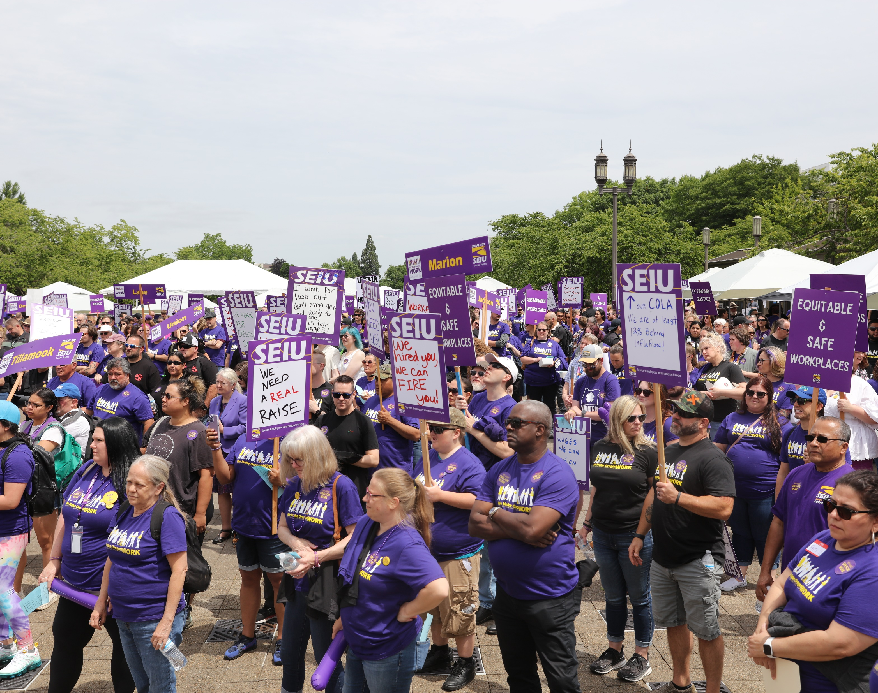
SEIU represents 72,000 people in Oregon including 25,000 State workers!
Notes:
[Contract Specialist] If you’ve never had a union job before, you may not know much about what they are about so we’ll go over all of that today.
There are lots of different kinds of unions that represent different kinds of workers like nurses unions and firefighters unions. Our union, SEIU, represents higher education employees like us who are providing critical public education services at all 7 public campuses across Oregon. We also represent over 40 state agencies as well as counties across Oregon.
Local 503 also represents homecare workers, nursing home staff, private nonprofit staff and some local governments. They have their own contracts. In total your union represents about 72,000 workers in Oregon which means you have a lot of power to bargain for better wages, benefits and working conditions.

Slide 3
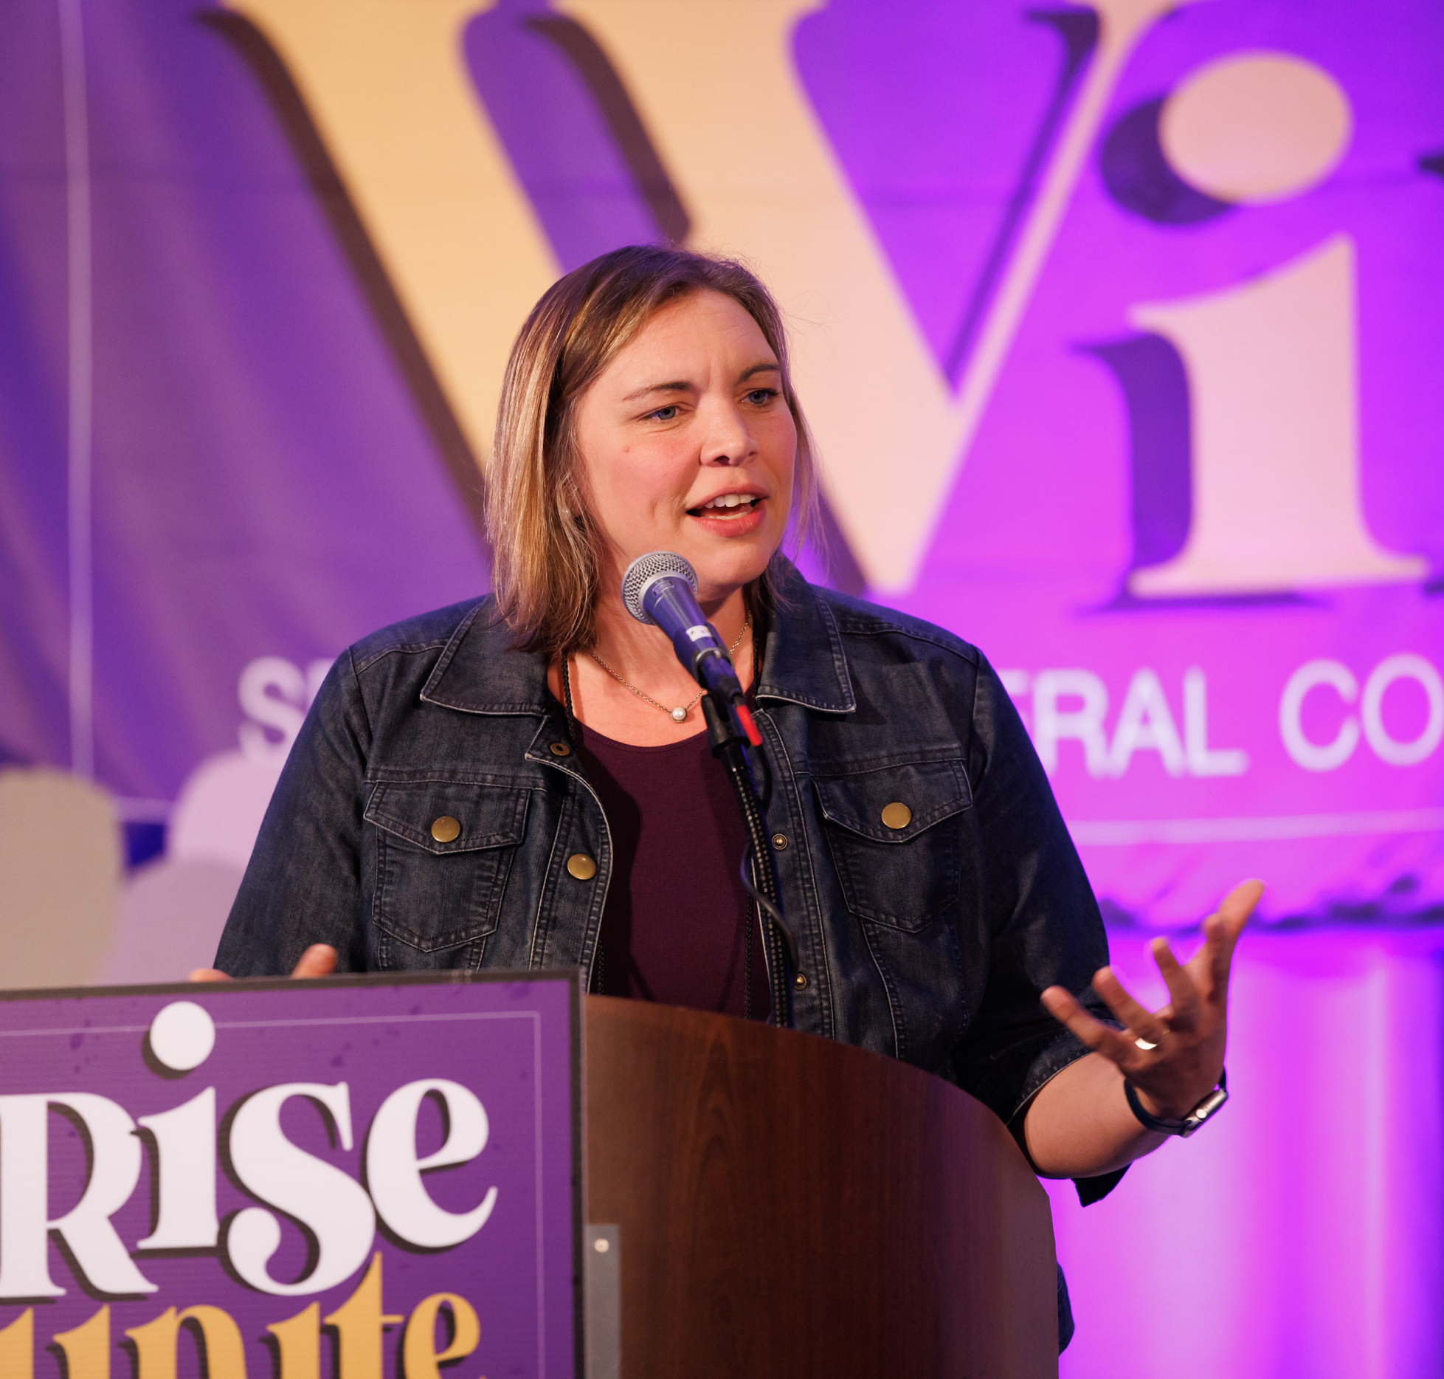
What is a Union?
A union is an organization of you and your coworkers, uniting together to make changes you can't do alone- to pay, benefits, and working conditions.
Unions also serve an important role making sure that management acts fairly and treats its workers with respect.
When we unite together, we have collective power.
Notes:
[Contract Specialist] Who has been in a union before? [wait for reaction] You may be hearing a lot in the news about unions right now because lots of workers are trying to unionize. Workers at places like Amazon, Burgerville and Starbucks are working hard to form unions because they want to win the right to negotiate with their employers over things like pay and working conditions.
Fortunately, as higher education employees you already have a union at your worksite! Having a union means we can use our collective strength to bargain for better wages, benefits and working conditions. Winning those things is a lot easier when there are tens of thousands of us instead of going it alone.

Slide 4
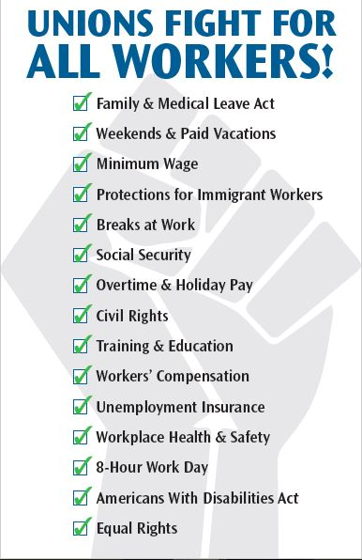
What do Unions Do?
Remote Work
Regular Pay Increases
Consistent Healthcare Premiums
A Say in Your Workplace
Protected Activity
An avenue for Improvement
Notes:
[Organizer] Historically when people think of unions and the labor movement they think of things won like the weekend, 8 hour workdays, child labor laws etc… But here’s how our union works for you on an everyday basis (Read and elaborate on some of the bullet points)
Avenue for improvement: Who here has every had the perfect job? A job where nothing is wrong and nothing could make it any better? That’s right, no job is perfect and there is always something that can be improved. The difference is in a non-union job you can ask but it’s ultimately up to the whim of your employer. In a union job they have to come to the table and listen at least every two years. And there is plenty more you can do in the meantime.
Negotiate contracts with Higher Education as a team.
When you have a union, that means you have won the right to have a contract with your employer to negotiate over pay, benefits and working conditions. Having a contract means that your employer can’t arbitrary change things, like for example cutting your benefits, without negotiating with you and your coworkers.
Most employers in the U.S. are what is known as “At Will” employers. Meaning you can be fired at any time, for any reason. But when you have a union, that means you have job protections. (“Just cause”)
Advocate for strong state budgets that include higher education funding so we can negotiate from a position of power
As publicly funded employees, the people who make decisions about how much money is available for higher education and the work you do, are state legislators. That’s why our union has a big role to play in the state capitol to advocate for smarter budgets!
Represent members and enforce the contract
As a union member, you have a right to union representation if you are ever facing discipline. You all have co-workers called union stewards who can go with you to any kind of disciplinary meeting. A union leader in your worksite will be reaching out to you for an orientation with more info on this. (Has anyone here been a union steward before?)
Give workers a say in their workplace
Our union contract creates Labor Management Committees where workers can sit down with management to discuss workplace issues, policies and procedures before things get out of hand. When issues arise, you have a voice in the process.
Build political power for bills and policies that benefit working people
Our union also builds legislative power for bills and policies that benefits ALL working people. A great example is raising the minimum wage which helped us advocate for everyone’s wages to go up. Another great piece of legislation we helped to pass is Paid Family Medical Leave, which just took effect.
All of our victories ride on the back of the past 100 years of labor activism. I feel that knowing where we come from helps us not take our contract for granted.

Slide 5
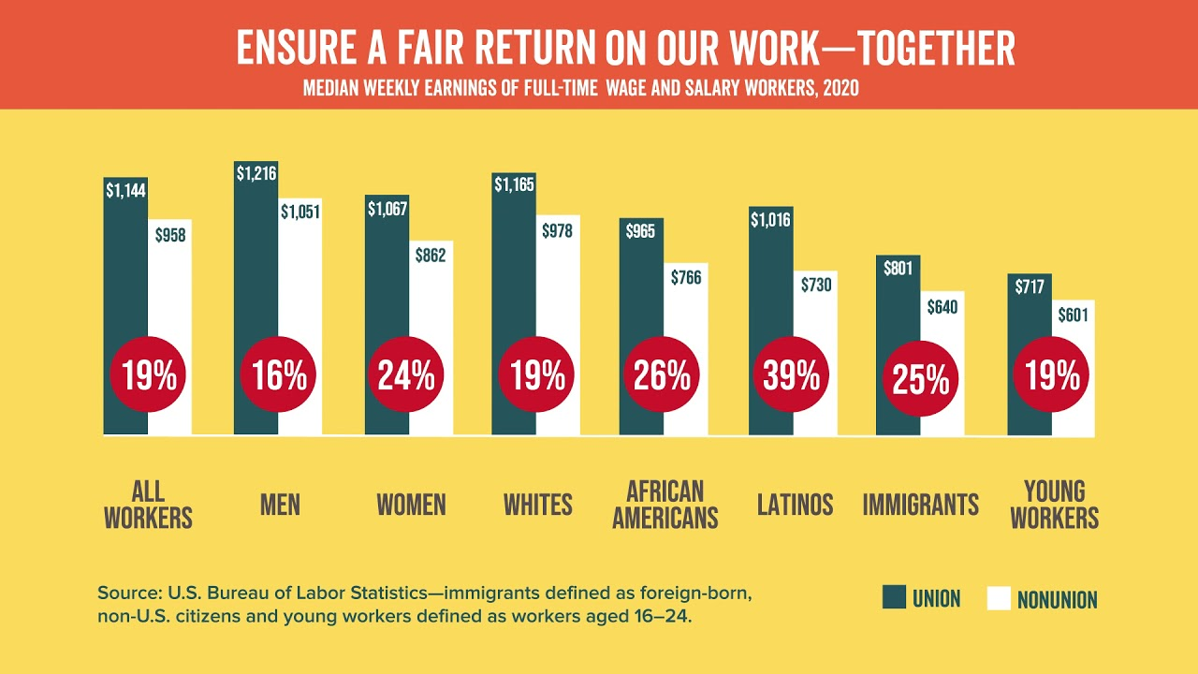
Do union workers get higher wages?
YES!
People with union jobs earn better wages and benefits than workers who aren’t union members.
On average, union workers’ wages are 19% higher than their nonunion counterparts.
Notes:
[Contract Specialist](Refer to info on slide) One of the biggest reasons worker choose to unionize is because union contracts win better wages! This is true across the board but especially true for people who have been traditionally underpaid like women and people of color. Union workers are in it together and fight for each other!

Slide 6
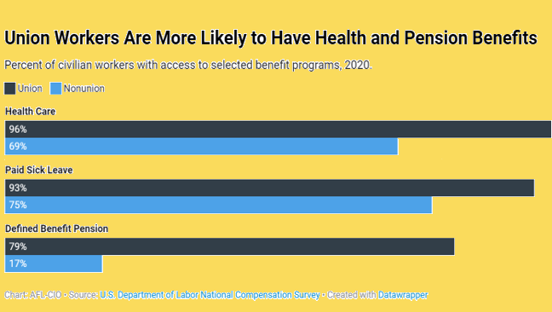
Do union workers get better benefits?
YES!
Ninety-six percent of union workers have employer-provided health insurance, but only 69% of nonunion workers do.
Notes:
[Contract Specialist] You heard about your benefits for the past hour that's a big area where you’ll notice the union difference! Union workers are substantially more likely to have health and pension benefits. (refer to info on slides)
I’m a member of the union because_______[include dues are 1.7% + $2.75/month and that's a good deal.]
-----------------------------------------------------
As you can see, union jobs come with better pay, and better benefits. This is made possible by something called dues, a feature of almost every union. Here at SEIU 503, dues are 1.7% +$2.75 per month. That’s a fantastic deal when you look at the pay increases that have been made possible by having a union in your workplace, as it allows your you and your coworkers to fight for better contracts.

Slide 7
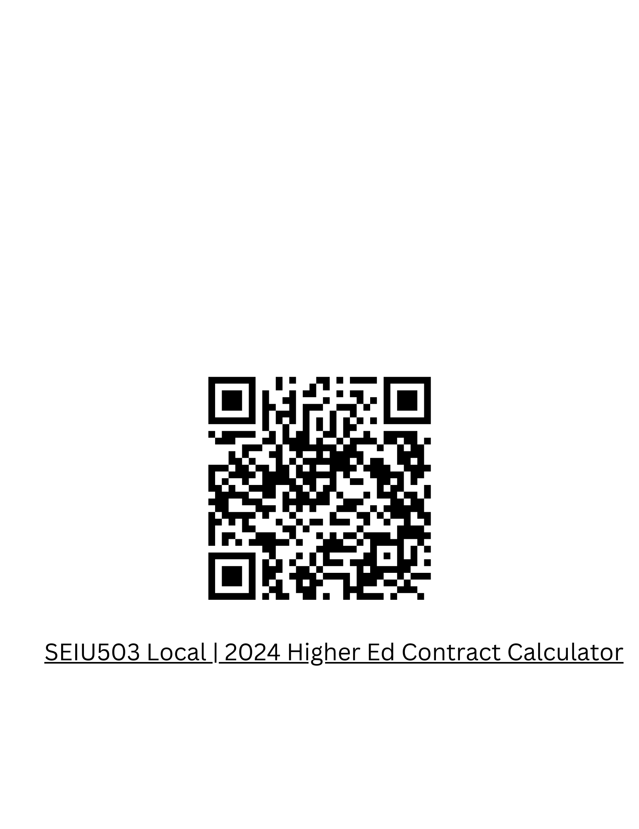
Bargaining for our new contract begins February 12 at UO check out our website for more information local083.org
What we a 15% Cost of Living increase in our last contract negotiation.
We won from power that YOU have to bring to the bargaining table by becoming a member today.
We are in bargaining and membership has said that these are the top priorities when we open up the full contract.
Economics
Benefit Protections
Workload and Worklife Balance
Union Power
Notes:
We are entering in to bargaining February 12! This means we must have union power – that’s you by becoming a member to negotiate a contract we must have to provide for ourselves and our families.
By choosing to join today, you will have the power to show management that we are the workers who make this campus run.

Slide 8
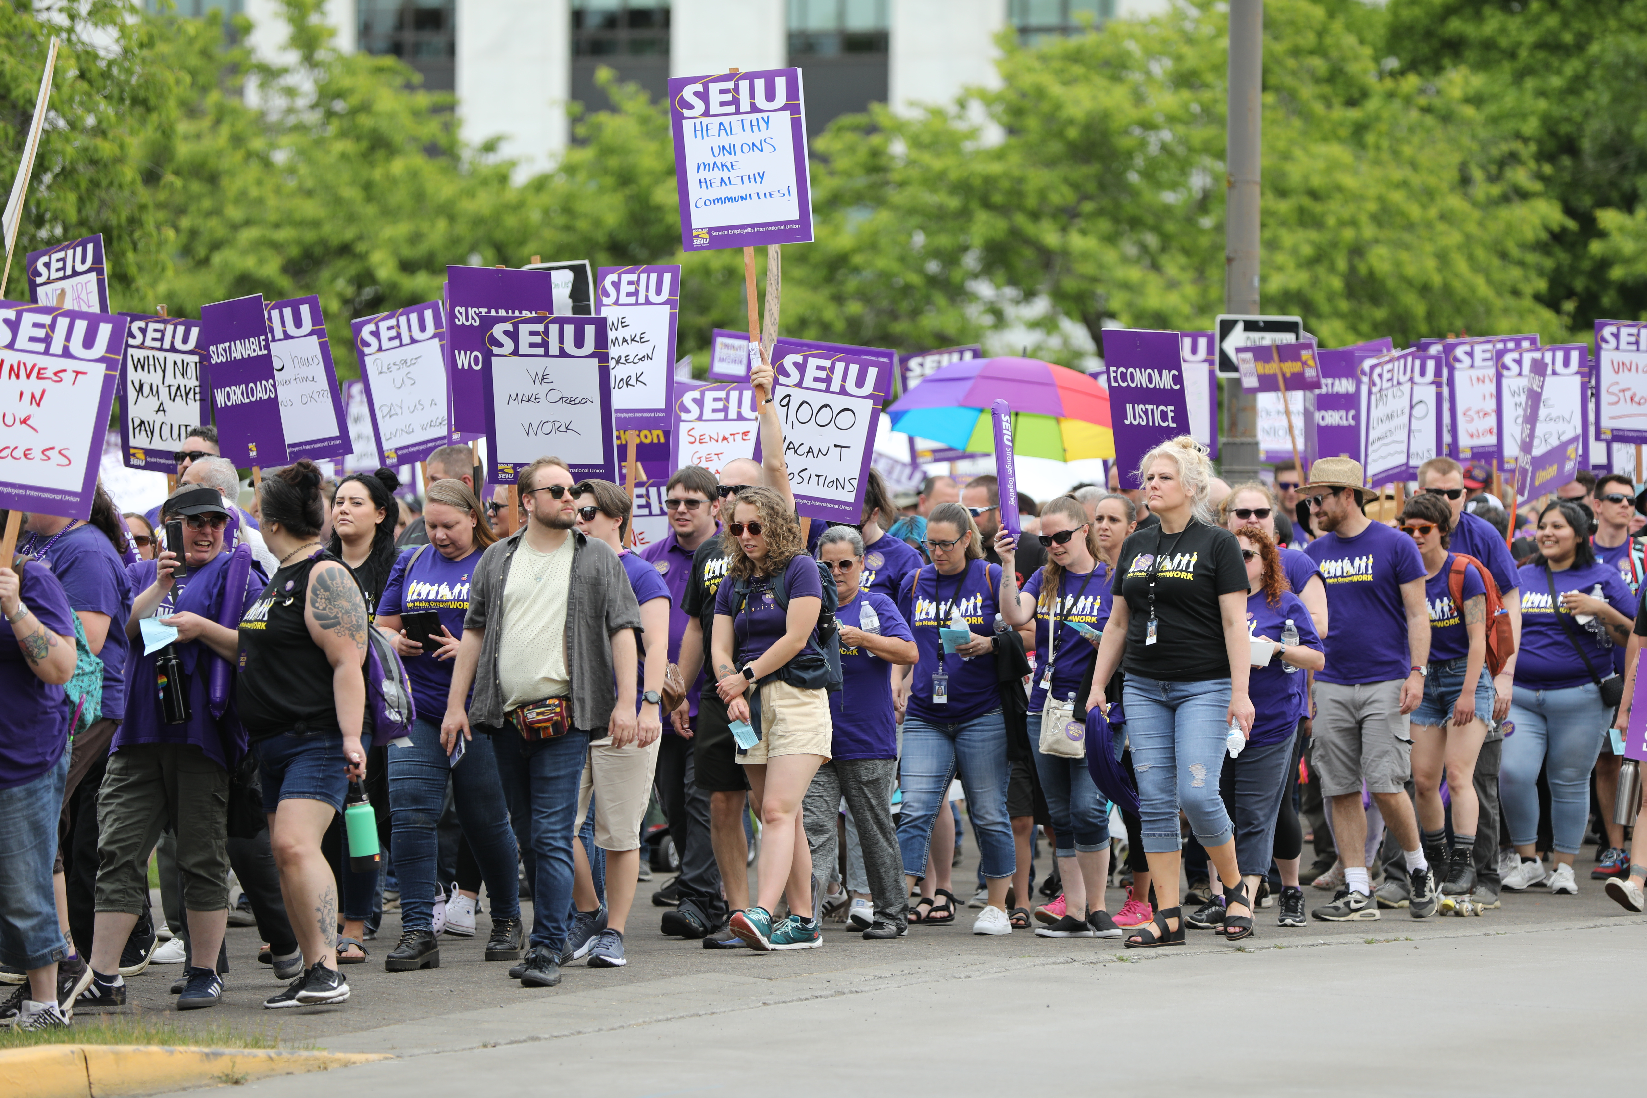
When we organize, we win!
A good contract means:
better wages and benefits
the freedom to take off time when you’re sick
the security of knowing you’ll be treated fairly at work
We have strength at the bargaining table when all members are engaged in the process, and willing to step up and take action to support each other.
Notes:
[Organizer] All these benefits and pay increases don’t “just happen”. They aren't automatic. These wins for workers are only made possible because you have strong membership in your union which gives you power at the bargaining table. There are organizations that don't like what state workers have won and want to undermine your benefits. You will hear from these groups by phone, email or postcard during your time with the state. [Those groups are funded by billionaires that have an interest in privatizing public work.] Most workers don't listen to what they say. Workers are in it together and know that your power is strength in numbers. That’s why it’s important that all new state employees choose to join Local 503 to make sure to keep winning good contracts. There'll be a chance to sign up in just a moment.

Slide 9

Additional Member Benefits
Life Insurance
Pet insurance
Legal insurance
Discounts
Scholarships for you, and dependents
And more!
Notes:
[Contract Specialist] We also get some great additional benefits for membership including additional life insurance, scholarships, low interest mortgage loans, discounts and more. You can even opt in to legal and pet insurance. We’ll send you an email after this with more details on all the benefits

Slide 10

Why Do I Need A Union?
Healthcare
Regular pay increases
Job security
Protecting your job
Budget advocacy
Winning on important issues
Control over your job
Notes:
Before we finish up and start the poll questions there are a few questions I would like to leave you with. Just some thing to mull over while thinking about becoming a member
●Your next pay raise: Where do your pay raises come from? It’s not your employer, and it’s not even the legislature. They are just the ones who agree to an amount and allocate funds. It’s union workers who bargain and set the bar that determines your paycheck.
●Your Benefits: What would you do if you suddenly had to pay double the cost for your health plan? Or if you had no say in what your insurance covers? All of these things are accomplished by having a union and folks choosing to be involved
●What will you do?: What happens if the next pay raise is enough, or if something major changes at work (like remote working)? Will you accept these things or will you wish there was something you could do to change it?
●Investing in yourself: How much are you worth to yourself? How much are you willing to invest in your own future? Do you think you are worth less than the 1.7% it takes to be a member?

Slide 11
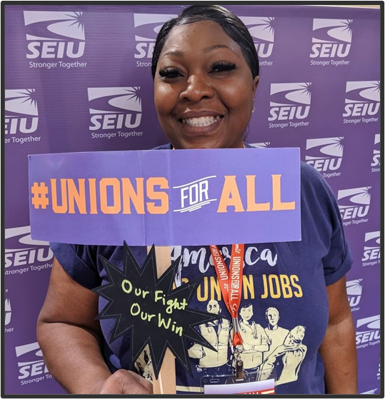
Become a Member!
More than a personal choice by joining today being a member you have power and a voice to increase your bargaining power for better wages, benefits, and other work conditions
Notes:
I want to finish our conversation with you all today by talking about the three pillars of membership
1) BECOME A MEMBER by completing the online membership form that was emailed to you.
●Dues are very inexpensive, only 1.7% of your monthly paycheck + a flat $2.75 a month.
●A good way to calculate this is: for every $1000 a month you make, dues are $17.00 per $1000 a month.
●As your co-workers move into bargaining in the middle of an economic recession and an unprecedented pandemic, it is important now more than ever for workers to come together and join their union to protect their pay, jobs, and benefits.

Slide 12
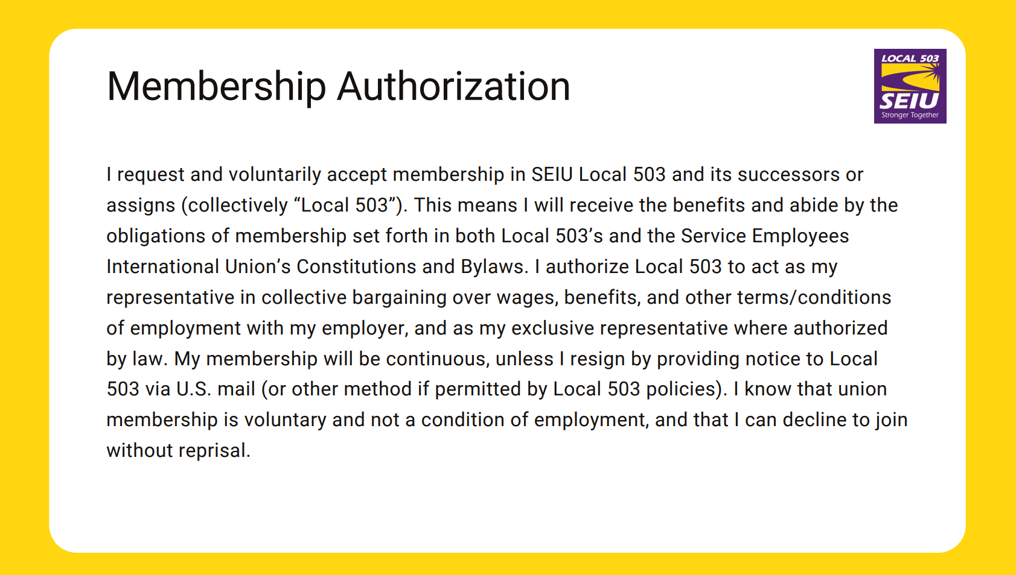

Notes:
Zips Slide 1: Membership
[Contract Specialist] Alright, this first poll is just going to ask you to become a member of the union. This is the exact language on our membership forms. For accessibility purposes, we’re just going to play the membership form out loud so you know what it says, then we’ll launch the polls.
You may think you've already filled out a membership form, If you want to be a member don't worry about saying yes again, you won't pay twice the dues. And, you will only be a member of SEIU while you work for the agency that you are currently hired at.
(Play Audio on slide and then launch poll 1. You will be able to see how many people are filling it out and you may need to nudge folks a few times to do it EX: “Great, looks like 3 more people need to make a choice”.)

Slide 13
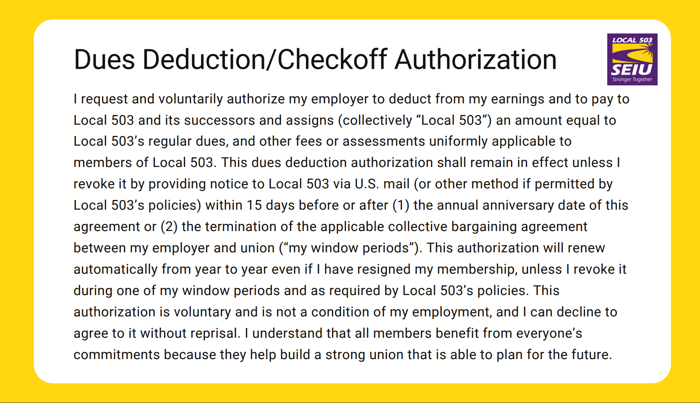
Notes:
Zips Slide 2: Dues Authorization
[Contract Specialist] Great, thanks for filling that out! The next poll is authorizing dues like we talked about earlier. If you selected yes to the first question, you need to select yes on this one too or you won't be a member!
(Play audio and then Launch poll 2)
Again, you may think you've already filled out a membership form, If you want to be a member don't worry about saying yes again.
As soon as everyone makes a choice we will move on. You will have future opportunities to choose to join your coworkers in the union.

Slide 14
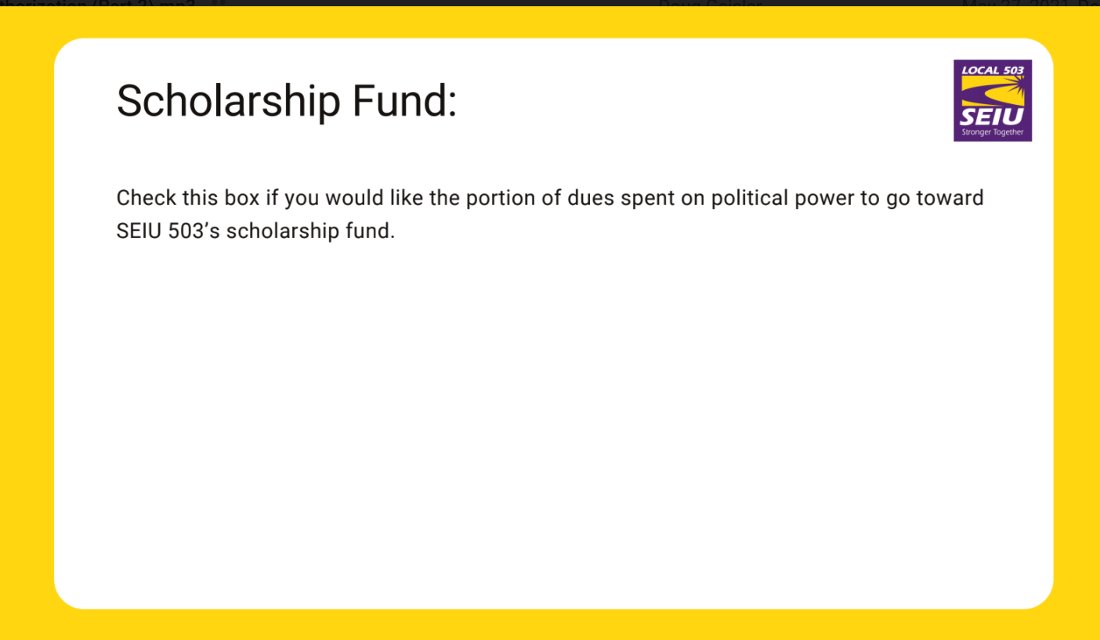
Notes:
Slide 3: Scholarship
[Organizer] 75 cents per month of dues goes to political work. A good example of this is the ongoing fight for smarter state budgets so y’all can do your jobs. So, I encourage you to choose NO to this question so that we can keep building political power. If you select NO that keeps your 75 cents going to building legislative power. If you select YES that 75 cents is diverted to the scholarship fund.
(Play Audio, launch poll 3)

Slide 15
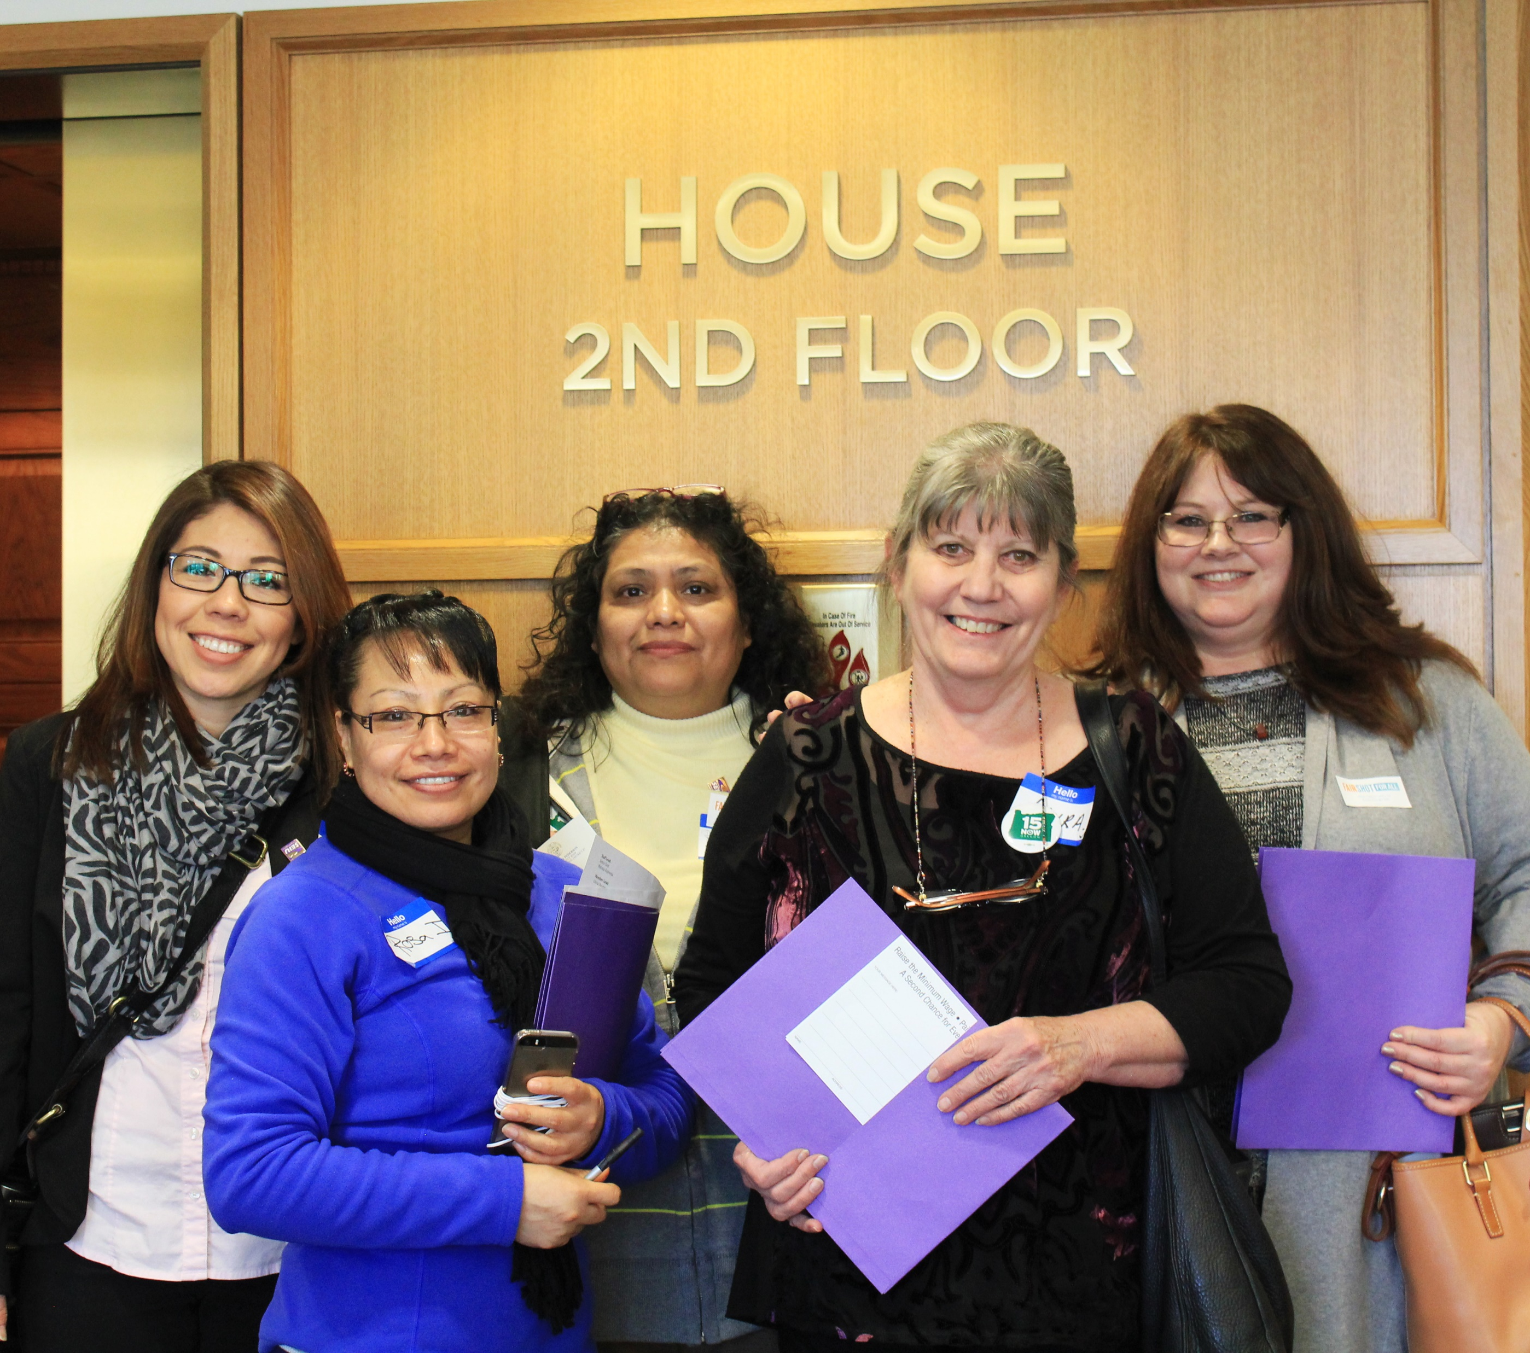
Political Power Matters!
Citizen’s Action for Political Education (CAPE) is a political action fund
Optional additional contribution to support building power
Contributing members interview and make choices about endorsements
Having a voice in politics is important because political decisions have a big impact on your pay!
Notes:
2) CONTRIBUTE TO CAPE. CAPE (Citizen Action for Political Education) is an additional contribution you can sign up for in a zoom poll that gives you power not just at your worksites, but in state and local politics as well. This is critical for those who work in government, because you have the power to elect your bosses and those who decide how much money is available for your pay, benefits, and the services you provide.
[Organizer]
In 2023's legislative session there were several laws written that impacted workers. Laws expanding State worker protection from harassment and bringing State Hospital workers better retirement benefits for the on-the-the-job risks they experience.
In order for these laws to pass, legislators that support workers needed to be in office. In order for there to be a smart budget that helps you get your work done, legislators that support that work need to be in office.
That’s where CAPE comes in; CAPE stands for Citizens Action for Political Education and is a political action committee you have the choice to give to and keep building political power. It’s tax deductible, and those who contribute get a say in what candidate is endorsed. As state workers you all are in a unique position, where the people who make important decisions about your agency are elected.
If these are the people who set the budget for your pay, wouldn’t you want a seat at the table?

Slide 16
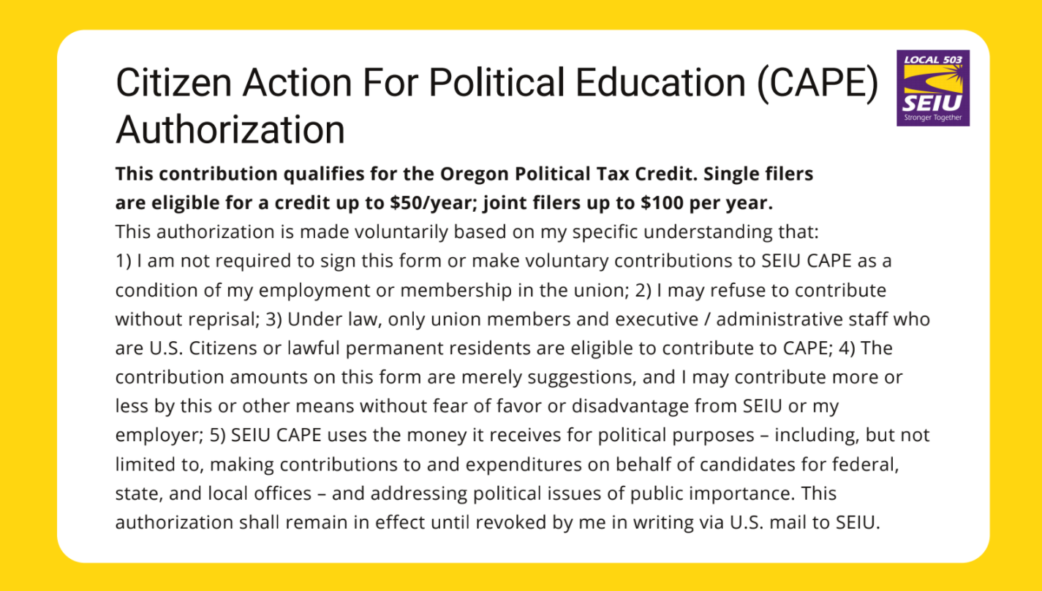
Notes:
(Play slide and launch poll 4)
This is the last thing for you to choose today.

Slide 17
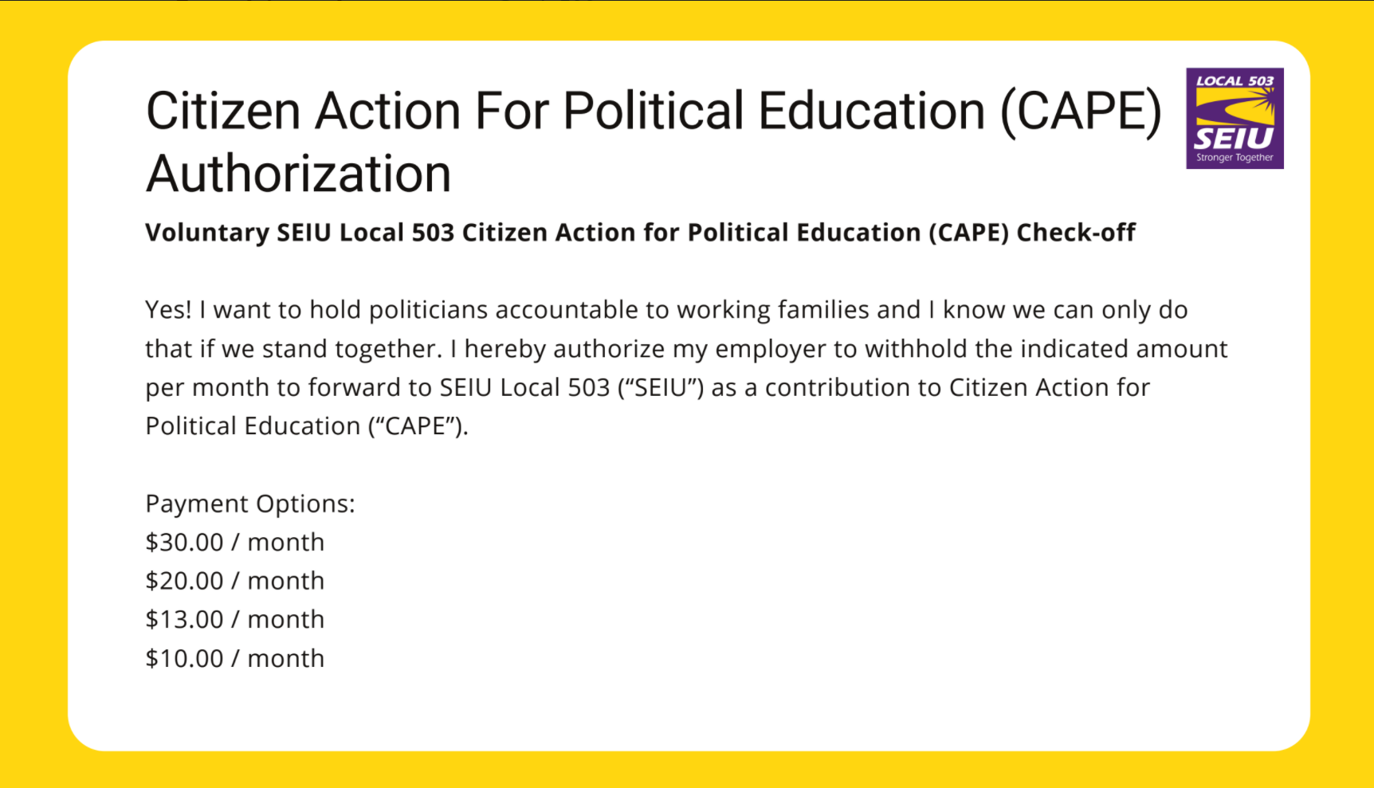
Notes:
Zips Slide 4 and 5:CAPE [Organizer] Next is the Political action committee we were talking about, CAPE! CAPE is an additional voluntary donation. It's tax deductible and those that contribute to it are the ones that vote on who gets Local 503's endorsements. (Play audio on both slides, then launch poll)

Slide 18
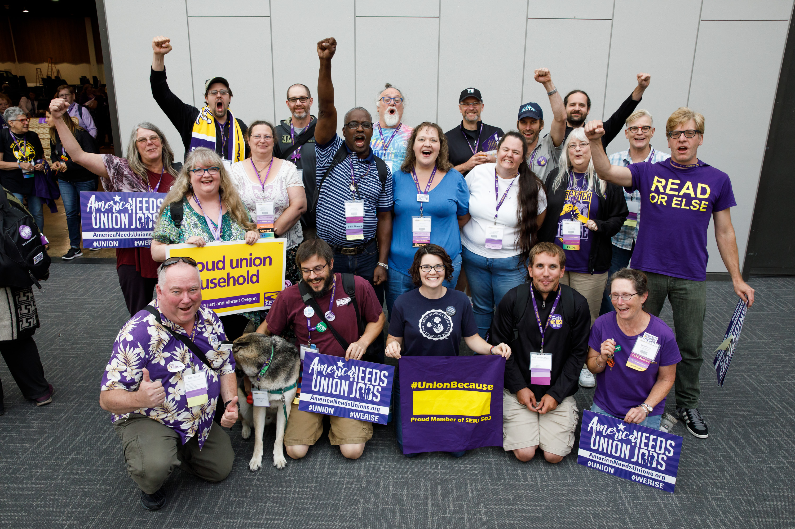
Welcome Higher Education workers!
Membership Meetings are the third Thursday of each month in the Memorial Union
12:00 – 1:00 Lunch provided!
Gino, Russ Jax and Local 83 Members
Notes:
3) PARTICIPATE! There are lots of ways to participate in your union. Please get involved! Your union is as strong as the members involved. There are lots of things to do, with roles that fit every interest, and the doors to participation are wide open. Our membership meetings are held the 3rd Thursday of each month, the next meeting will be ______ 12:00 – 1:00 at the MU, and we also have a hybrid option over zoom! Reach out to Andrew, Gino, or myself if you have any questions, and
[Contract Specialist] Wrap Up
Thanks everyone. We’ll send you a follow up email with more information on your contract and union benefits. You will also be getting a call or email from one of your co-workers in your office who will give you more office specific union information. So please connect with them! Thanks and have a great day!

